Slide 1


| COMPANY PROFILE
Re-Imagining Partnerships -Together!

Slide 2




Discover the Power of
PARTNERSHIPS with a long-term approach
| Table of Contents
03
About | Our STORY
04
Our APPROACH
05
Building STAGES
07
About | Our CORE VALUES
Our INTEGRITY
Our PEOPLE
Our INNOVATIONS
08
About | Our COMMITMENT
Our MISSION
Our VISION
Our STRATEGY
10
About | Our COLLABORATIONS
11
Our STRENGTHS
12
Our BELIEF & FAITH
13
Our WORKMANSHIP
15
Our TEAMSMANSHIP
16
About | Our APPRECIATIONS
“when we Empower EACH OTHER, we Enable OUR FOOTPRINTS to spread without limitations.
02

Slide 3


| OUR STORY
#WeAreMGK, our journey began in 2019 in Nairobi, Kenya (EA) to connect African businesses with strategic development partnerships with a Purpose driven approach “TURNING VISION INTO VALUE”. This Purpose, ignited our revolution into various sectors through the synergy of integrated skills. We offer a unique operating business model building meaningful business partnerships and ensure “Our Purpose”, is felt through every stage as WE TRANSFORM PEOPLE’S LIVES, one connection, at a time.
We are the center point of reference and intersection. We Respect the principal of sustainability and transparency. “Our goal” is to GROW TOGETHER, “Create Possibilities” by challenging the status quo, pushing boundaries to discover new working ways . We believe, to put partnership goals first and we’re passionate about success . We’re searching for innovative solutions to business challenges, developing brands, expanding into markets, Building business relationships, Investment solutions, Joint Ventures Break-through thinking, agile, creative and Bold.
We have built our reputation by providing “VALUE ADDED SERVICES” that enable our Partners attain their goals and objectives . We believe, Profits and Principles are not mutually exclusive . The value of what we do is also measured by the attention we pay to the impact of our activities to the community . the connections we create and how they reinforce each other is key in how we measure our success.
We encourage ourselves to doing great things with;
OUR PEOPLE . OUR PARTNERS . OUR COMMUNITIES . OUR BUSINESSES .
OUR aim is to help build and TURN OUR CONTINENT’S VISION INTO VALUE.
A company’s success is
RECOGNIZED
by how they make a
POSITIVE IMPACT
in the lives of others!
03

Slide 4


| OUR APPROACH
THE PURPOSE
We believe there is total power in building and growing highly effective partnerships, with a common mindset, committed to mutual excellence and long term positive impact to our communities. We build active partnerships - Provide On-Site strategic support - Develop detailed work-able plans and when we’re needed, - we provide the value chain day-to-day advice and problem solving support.
DECISION MAKING
We use collective experience and expertise to develop and understand the vision and anchor our results on proven facts, data and findings to support ambitious visions to achieve sustainable outsized results. However, accountability is the key to our success; hence we guide and advise through the entire strategy and the implementation process.
MEASUREMENT AND EVALUATION
We invest where visions and value are achievable and sustainable as well as tangible and measurable to achieve continual improvement and long term results. We take calculated risks, with off-take guarantees and clear objectives, we fail forward and embrace continuous improvement.
We believe in building
Abundance-based Partnerships
“ OUR FINGERPRINTS are our VALUES built on the theory that if we align
our thoughts and feelings with positivity and mutual purpose,
we will print them in the work we do.
04

Slide 5

| BUILDING STAGES
Stage #1
IDENTIFY SUSTAINABLE PROJECTS
+ FEASIBLE BUSINESS PLAN
Stage #2
Stage #8
DEFINE THE PROJECT PROFILING + CONNECTING A PARTNER
EXIT STRATEGY + SHARED RISKS OR PROFITS
Stage #3
Stage #7
COMPREHENSIVE DUE DILIGENCE + SYNERGY PROPOSAL
JOINT POSSIBILITY OF INNOVATIONS + INVENTIONS
Stage #4
Stage #6
SIGNING OF JOINT PARTNERSHIP AGREEMENTS (MOU + JVA)
ASSIGNED DUTIES & RESPONSIBILITIES + CONTROL OF SPV OPERATIONS
Stage #5
PROPOSED SHARED RESOURCES +
SET UP SPECIAL PURPOSE VEHICLE
African Collaboration FABRIC!
(Together we can Re-shape the process).
05

Slide 6
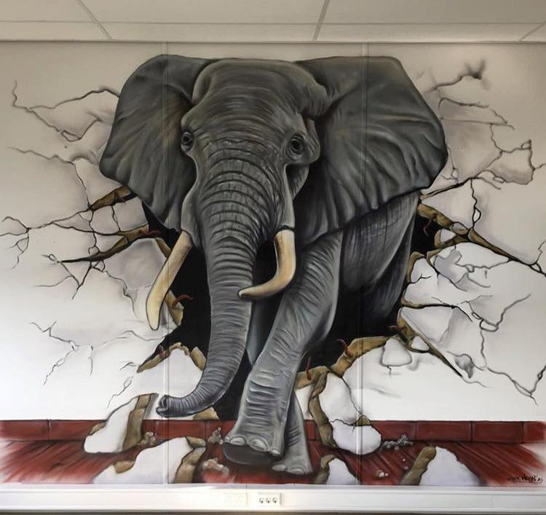
| UNIQUE PARTNERSHIP
OUR MOST VALUABLE ASSET, is our business approach, the relationships we build with our partners and Our Reputation. We believe in creating diversity in Our Workmanships and each individual’s initiative is well balanced through Our Teamwork.
OUR PROFITABILITY MUST BE COMPATIBLE WITH OUR SOCIAL RESPONSIBILITY:
In order to achieve optimum success, we must balance what we do to positively impact Our Communities. We strive to anticipate the individual needs of Our Partners and develop Bespoke services that meet their respective growing needs. To achieve the interests and success of our Partners is the measure and reward of Our Own Success.
RE-IMAGINE VIABILITY MEANS, provide excellent service with superior returns to our partners, attract the best professionals, research and understand the long term needs and Mutual interests. We diligently seek to develop and expand Our Relationships with new ways of working from various experiences and backgrounds that compliment Our Purpose.
RE-GENERATIVE THINKING MEANS, we create value in a wider eco-system to help the system self-sustain and thrive long after we are done. Nurturing people who depend on the natural systems we develop and directly draws from our support making our work for the community a source of Growth, Creativity and Innovation.
Building our Strong Narratives, Proof-of-Concept
“We believe, it’s through OBSTACLES we can widen the success of
CONNECTING AFRICA’s sphere of influence!
06

Slide 7
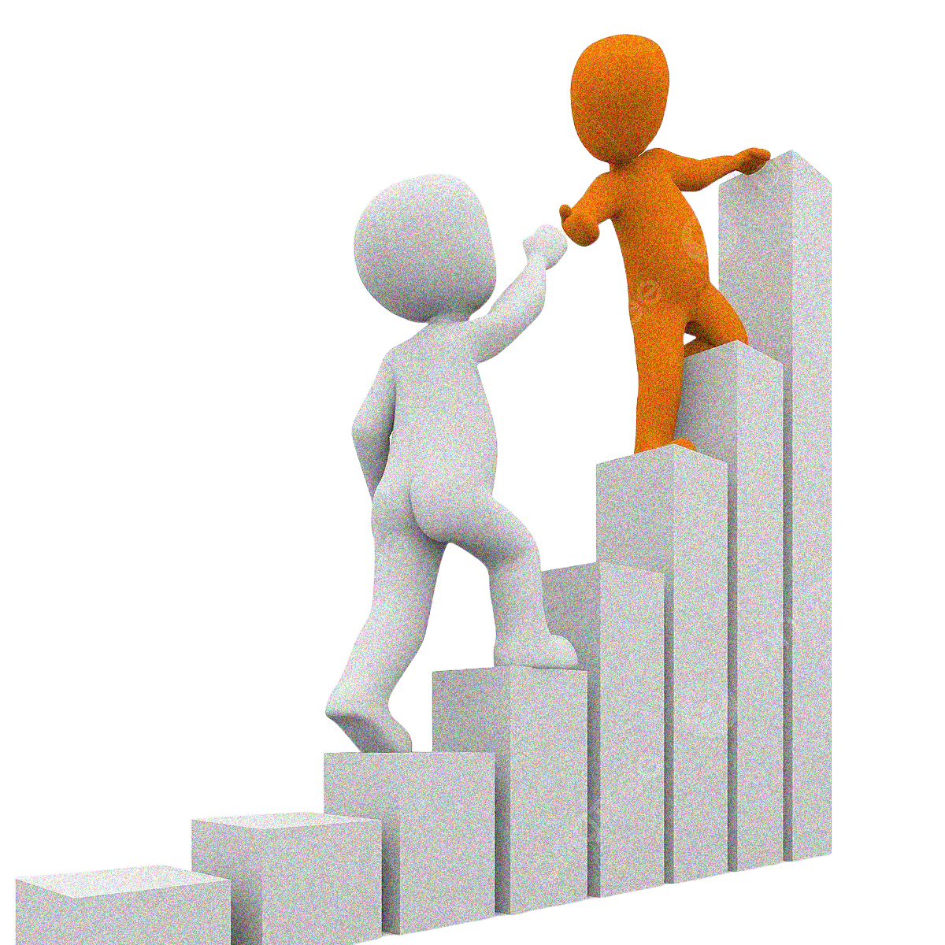

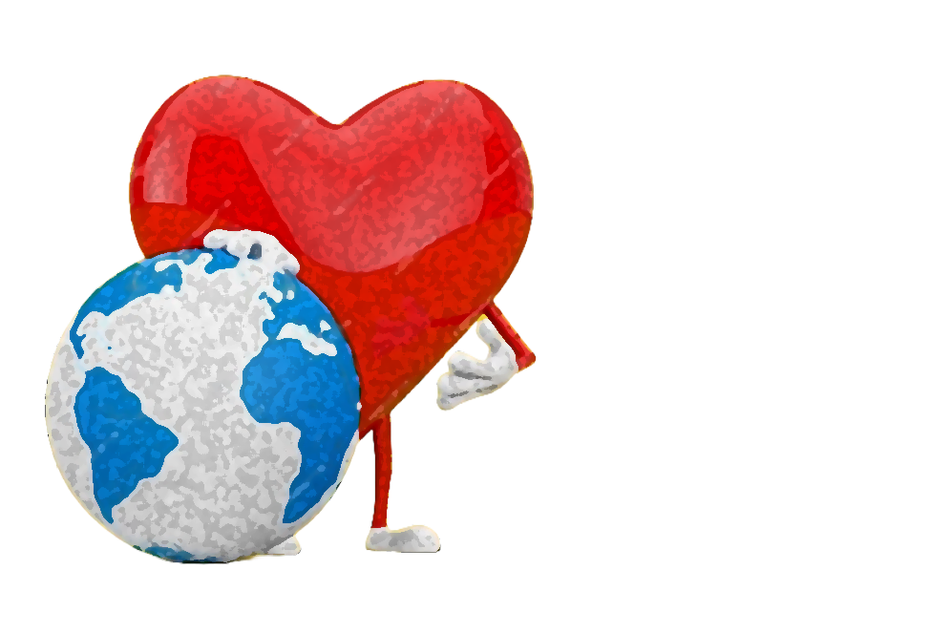
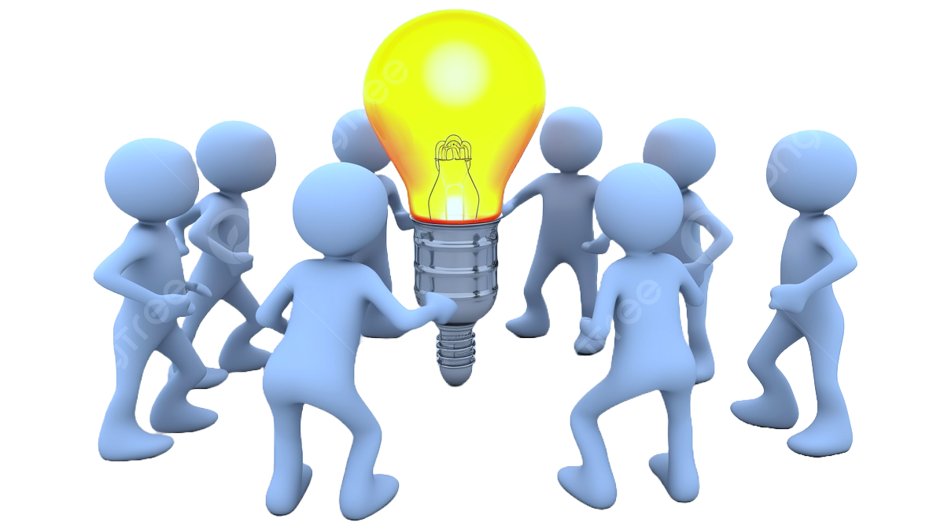
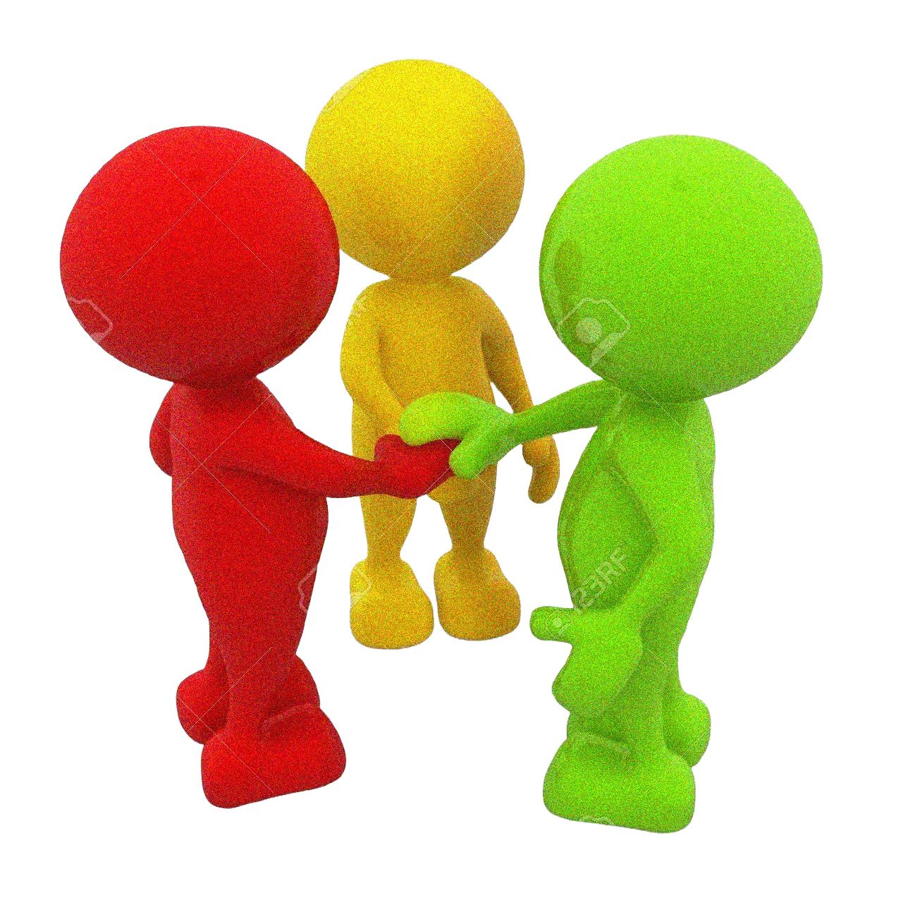
“Our values bind OUR SPIRIT of Togetherness!
We’re a dedicated, small impactful, highly focused firm with clearly monitored
and measured deliverables.
| OUR CORE VALUES
We Be the ONE!
We celebrate our unique diversity + individuality + dedicated workmanship and our Reputation is our greatest value
We Work with Heart!
The only constant in life is change so We care deeply about the impact our work leaves in this world
We Lift Others Higher!
We continuously seek new ways to work together, build long term partnerships and deliver value proposition to our Partners.
We Bring Energy + fun!
We understand integrity is Honesty,
Honesty is telling the truth and the truth
will enable us identify as a high-performance
intergraded consultancy firm.
We have The Family Spirit!
We focus on empowering and challenging ourselves by fostering a collaborative and mutually supportive Environment
07

Slide 8
| OUR COMMITMENT
The M’Group, was established to support the many visions and the great potential we lose. Through the partnerships we create, these visions are actualized through our passion in building tailored Mutual connections and Solid win-win relationships.
We are dedicated in turning visionary dreams into value with our trusted business partners;
“OUR DREAMS, NO MATTER HOW FAR APART WE ARE PHYSICALLY, THEY ARE INTERCONNECTED.”
The best part of our commitment, is in our dedication to bringing people together and combine strong ideas with resources and visions become tangible value.
| OUR MISSION
There is this notion that to grow a business and be successful, you have to be ruthless. That you have to do it all alone and in keep all others in the dark. That the less others knows the better.
We know there's a better way to succeed . A way that is built on partnerships is good for the bottom line and is good for the partners .
“BUSINESSES GROW WITH A CONSCIENCE, AND SUCCEED WITH A SOUL WHEN WE DO IT TOGETHER”.
That's why we've created a platform uniting business partners and developing communities to help our people benefit from well managed collaborations.
“WORKING DIFFERENTLY is how we approach THE DIFFERENT OPPORTUNITIES,
because we’re BUILT DIFFERENTLY.
08

Slide 9
| OUR VISION
Becoming a leading, trusted Business Partner means working constantly to deliver a bespoke end to end solution to meet the specific vision of our business partners.
The strategy, is to increase our focus on accelerating our business portfolio, deliver innovative solutions, identify and merge partners with shared visions who benefit from our constant engagement and evaluation of possible tailored and favorable solutions.
“WHEN WORKING TOGETHER, WE AIM TO SUPPORT AND DEVELOP WELL STRUCTURED OPPORTUNITIES THAT MORE ACCURATELY REFLECTS THE MARKETS WE SERVE”
We consider our collaborations, an extension of our vision - building stronger and solid mutual relationships.
| OUR STRATEGY
Playing in an attractive niche market within selected industries and expanding beyond our core market of consumer activities into the much larger trade segment.
In the coming years, our main growth drivers will be in improving Affordable Housing and Infrastructure Solutions and we aim to extend our capabilities to innovate new business models and enhance partnership engagement.
“OUR GROWTH, IS SUPPORTED BY OUR STRENGTH AND CAPABILITY IN FULFILLING PARTNERSHIP NEEDS IN AN INCREASINGLY COMPLEX REGULATORY ENVIRONMENT”
We combine our team, with our strong pipeline of sustainable projects. Concurrently, we focus more aspirational initiatives to enhance our long-term advantage.
“When we WORK TOGETHER, WE COMPLETE more within PARTNERSHIPS,
than we accomplish as individuals!
09

Slide 10







| OUR COLLABORATIONS
Partnerships are what make US great!
Creating a network of institutions that will become familiar with the processes and we are confident we match the Best-fit Partners to help achieve the vision.
Enterprise Limited
We continue to create opportunities to connect and share great conversations with amazingly intelligent and dedicated Entrepreneurs.
We’re forever grateful to their contributions and, we are forever changed because of their participation.
Where good living begins
When Creating an EVOLUTION OF DIFFERENT COLLABORATORS it means,
Re-Thinking capabilities so as to explore the endless POSSIBILITIES working together to
RE-SHAPE OUR VISION.
10

Slide 11
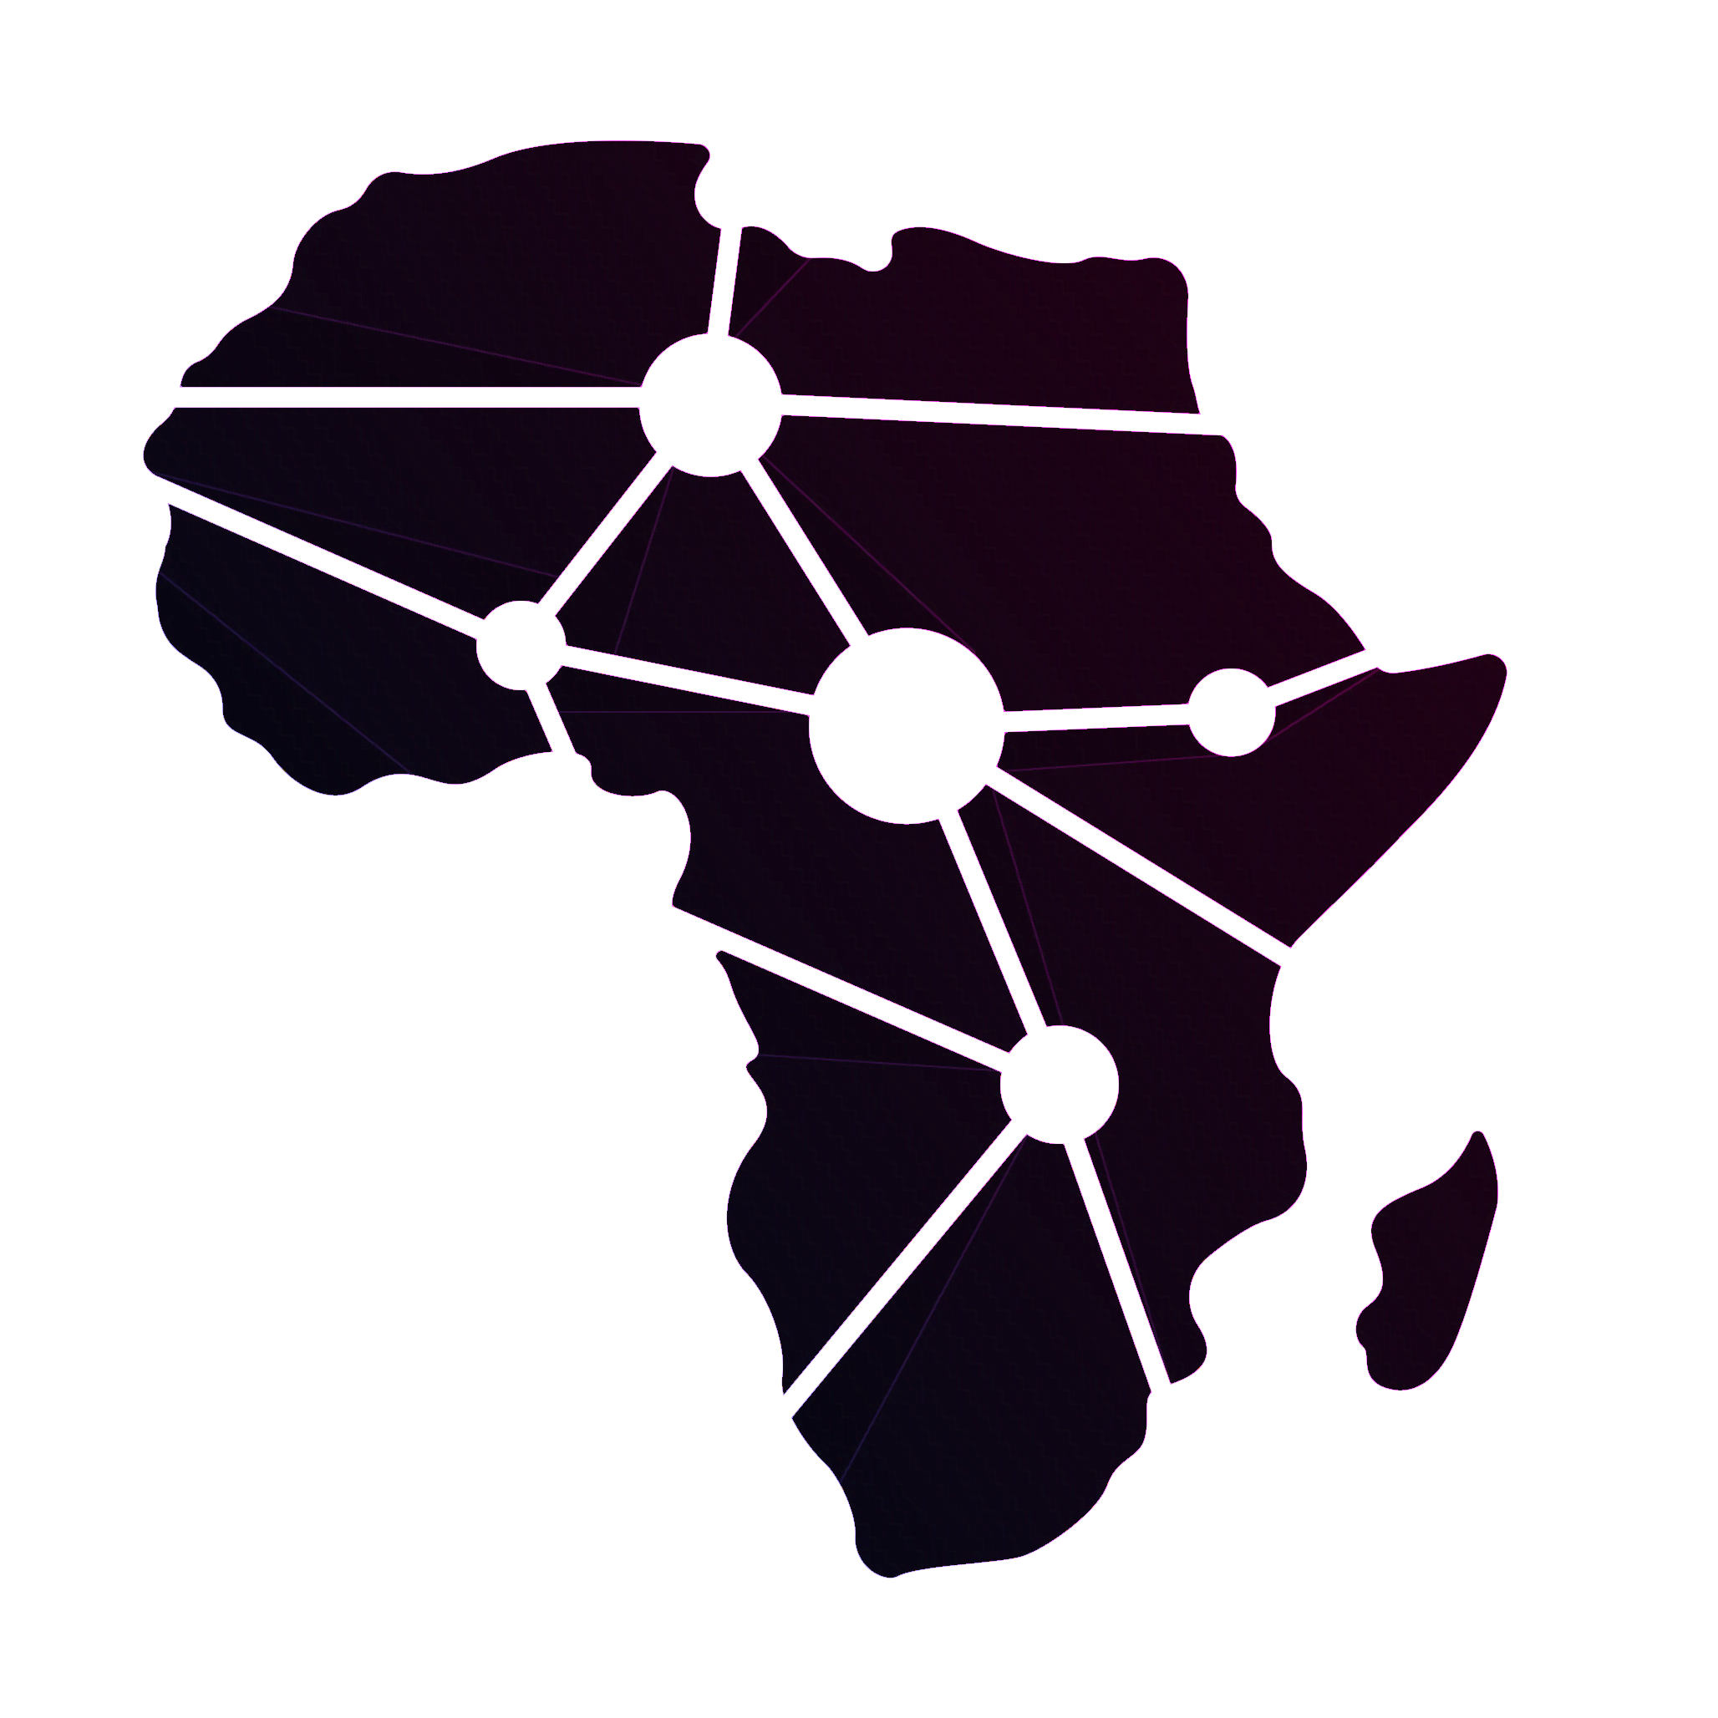
| OUR STRENGTHS
Our Partners’ have extensive commercial AFRICAN & GLOBAL NETWORKS,
in-depth knowledge of strategic market behaviors and solid relationships with KEY industry players.
Our Partners’ have extensive experience engaging with international financial institutions at AFFORDABLE RATES that support development projects especially in Africa.
Our Partners’ have an excellent Track
record successful driverables in various
PROJECT IMPLEMENTATION
In Kenya and Across Africa.
Our Partners’ are Committed to local
COMMUNITY DEVELOPMENT
and the sustainability of the environment and compliance procedures.
Our Partners’ have
EXTENSIVE EXPERIENCE
and expertise to deliver projects in line with Approved Budgets, Quality Standards and on Time.
Our Partners’ are from diverse backgrounds and a highly skilled and KNOWLEDGEABLE SUPPORT
team with extensive experience in various industries.
Together we’re building AFRICA’S
LARGEST INDEPENDENT
network of Partnerships!
We are Connecting Partnerships that help build and grow the companies we love,
and in our diversity we ask the right questions and our inclusive teams find better answers.
11

Slide 12
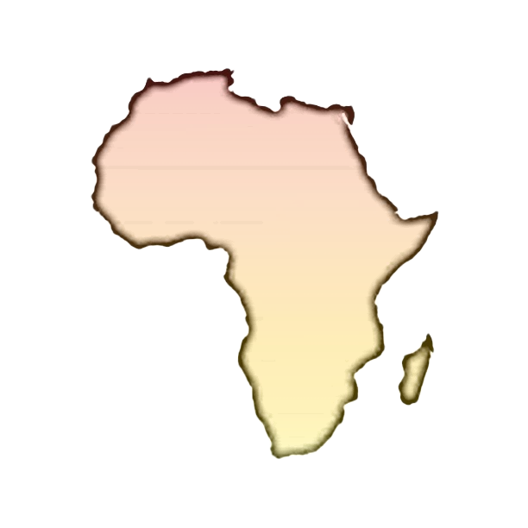
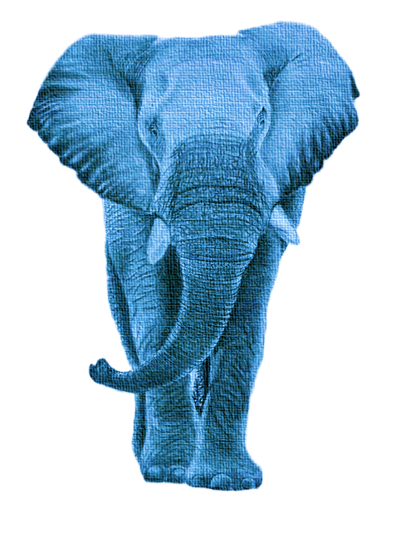
| OUR BELIEF & FAITH
Remember, behind the joyful celebrations when we achieve success, there are countless that almost achieved. Building a company means accepting challenges after challenges, many sleepless nights, self-doubts, obstacles, and the every day reality of committing to this incredibly hard, and in many ways, irrational, journey to achieving success.
The catch - (22); in some days, things are easy to explain and to understand, while in other days you’re questioning the same logic. Other days people understand your vision and in other days, you’re surrounded by skeptics and naysayers. There is no routine, no playbook, no safety net to success. The one true common denominating factor, “will be you’re faith and trust when you ask the Almighty’s guidance and the willpower you need to focus on the purpose that got you started”.
Like the (ELEPHANT), WE; take pride in being a (FAMILY). WE; face daily challenges, obstacles, rejections, (TOGETHER). WE; are constantly searching for innovative strategies to transform obstacles into opportunities and inspirations for the change we are working to create. WE; never fear hard work because, by working smart together we can gain immeasurable success. WE; remember our “Purpose” defines our ambition, being relentless in our pursuit of the vision.
“it takes a special
PERSEVERANCE when we faced
with adversity to gain the courage to bear a
Beautiful Patience”
We try emulate the incredible power of the (AFRICAN ELEPHANT HERD) when together they share;
WISDOM, GOOD LUCK, DETERMINATION, PATIENCE, PROTECTION, AND STRENGTH.
12

Slide 13

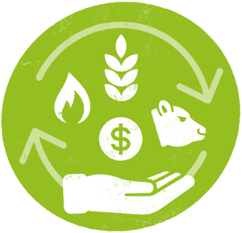

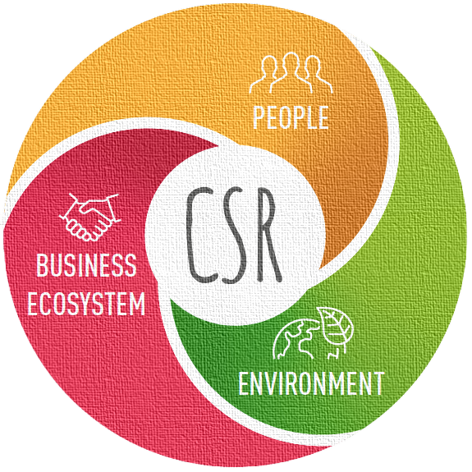



| OUR WORKMANSHIP
In our dedication to building stronger partnership connections, we aim to reduce the gap on funds allocated in Africa against funds available for the actual sustainable opportunities. In our everyday mission we explore extraordinary growth opportunities, work with the most talented and honorable partners while placing great emphasis on trust and long term mutual business relationships and local community development.
We are always striving to be in these attractive new exciting and challenging spaces, creating a living and working environment with the “MGK STAMP OF PARTNERSHIPS”.
As key advisors and administrators, we bring together the necessary expertise to structure and develop the most innovative and dynamic Joint Venture Agreement initiatives.
Infrastructure & Construction
Energy | Power | Renewable
Housing & Urban Development
FMCG Sales & Distribution Networks
Agribusiness & Commodities Trading
Community Social Impact
“We are PROBLEM-SOLVERS, focused on tailor-made Consultancy and
UNLOCKING PARTNERSHIPS that create real impact”
13

Slide 14
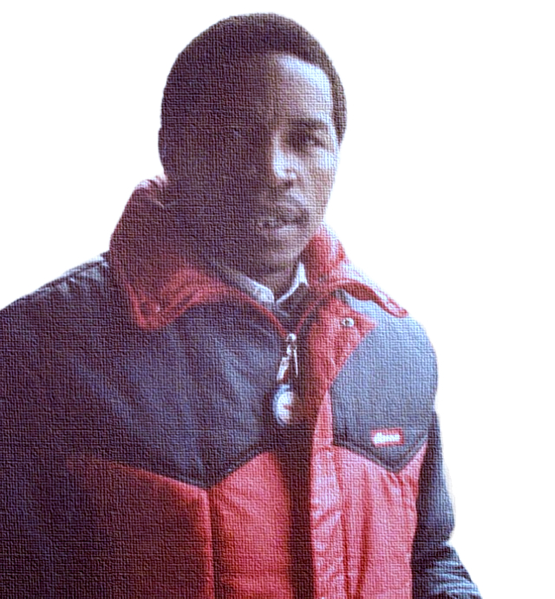
| OUR TEAMSMANSHIP
Our Partnerships are the key ingredient that makes up our workforce, and the Foundation our work is built upon. Leadership, experience, and the ability to leverage a strong local and global network is where we strive. Integrity and cultural sensitivity are key to our fulfilling mutual commercial success and growth. We cultivate our experience and expertise to offer bespoke advisory value add support.
With our extensive backgrounds we’re;
Open . Challenging . Collaborative . Diverse Cultures . Educational
Our Partnerships are a truly integrated workforce with, savvy entrepreneurs and industry experts, bringing years of experience into a young consulting firm. We cultivate our strong culture and work tirelessly to provide guidance, support and we challenge our partners to scale their potential to grow, and succeed.
The thing that makes our team stand out is, we have the teamsmanship that will match your mindset and work ethic. We provide a working environment that inspires people to Dream Big, and provide fair access for all people to fulfil their visions. Because they know nothing of the impossible . we’re proud of our partnerships.
JOHN MUCHERU MUNIU
CHMN EMERITUS
NOV.17,46 – JUNE 26,96
“It’s only in GROWING UP and STEPPING FORWARD we really
APPRECIATE THE EFFORTS of those who paved the way so, WE TOO ARE ABLE TO BUILD
OUR OWN PATH”
14

Slide 15




Together our profound expertise, knowledge and experiences of the African continent markets,
our continuous innovations and our extensive networks make US the ideal partner.
B - identified . Be involved . Become the impact
Let’s journey together!
Location: Kibagare Way - Loresho, Nairobi, Kenya | Website: https://www.themgroupkenya.co.ke | Email: ask@mgk.co.ke

